Slide 1
Gimnazija
‘Stevan Jakovljevic’
Vlasotince, Serbia
Communication – the Human Connection
eTwinning project
2015/16

Slide 2
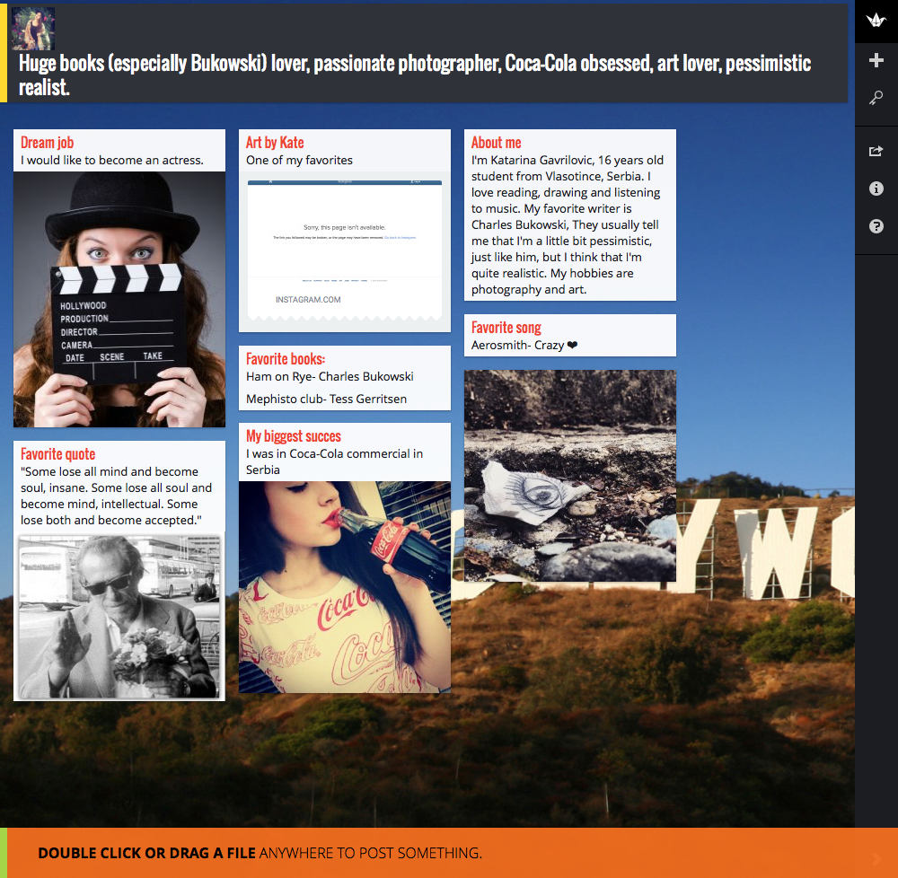
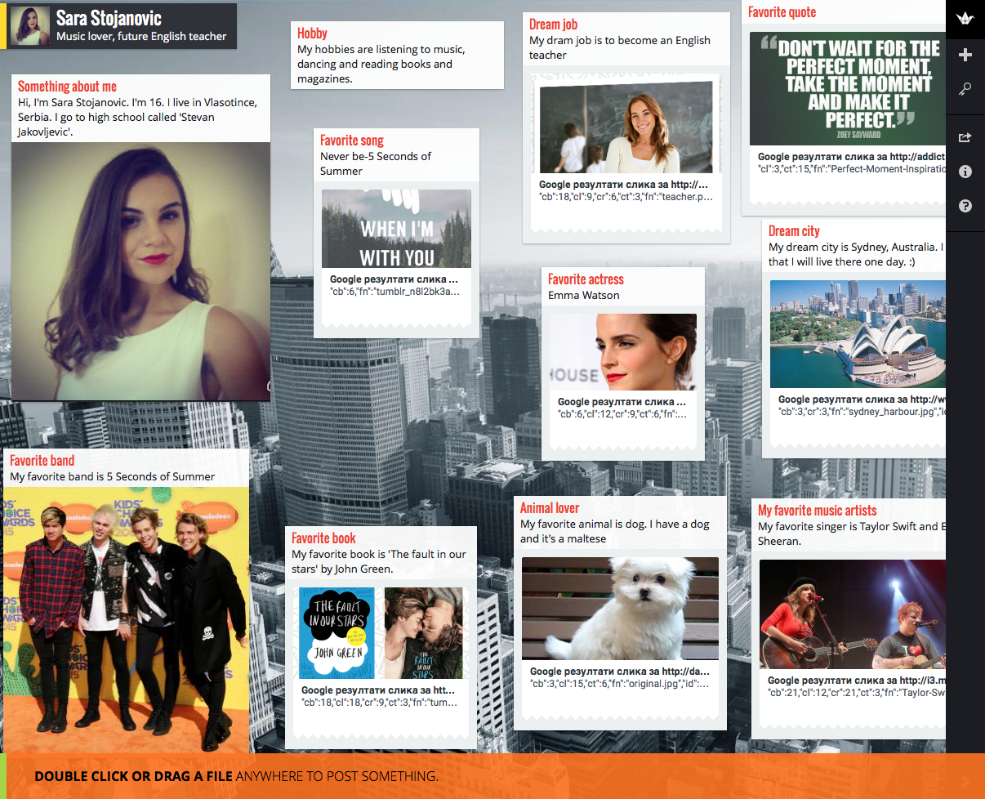
Students’ presentations

Slide 3
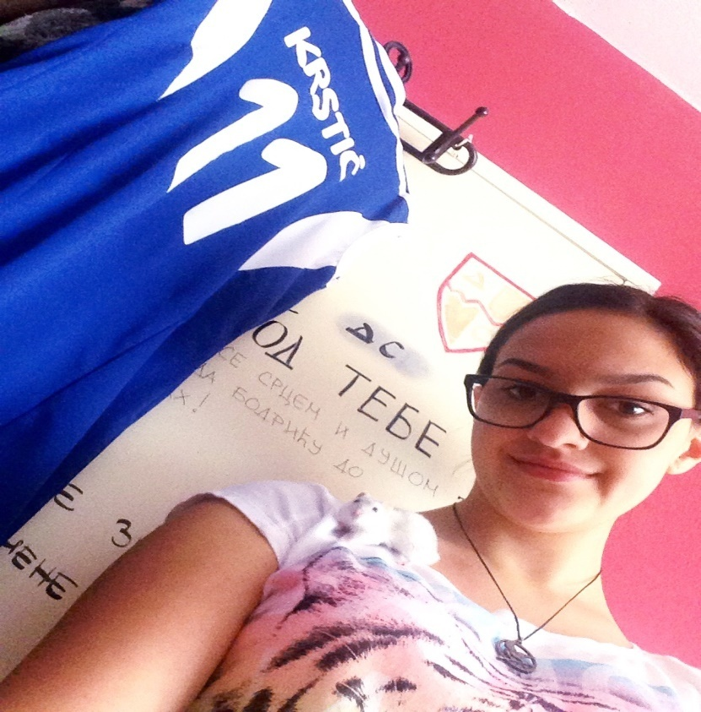
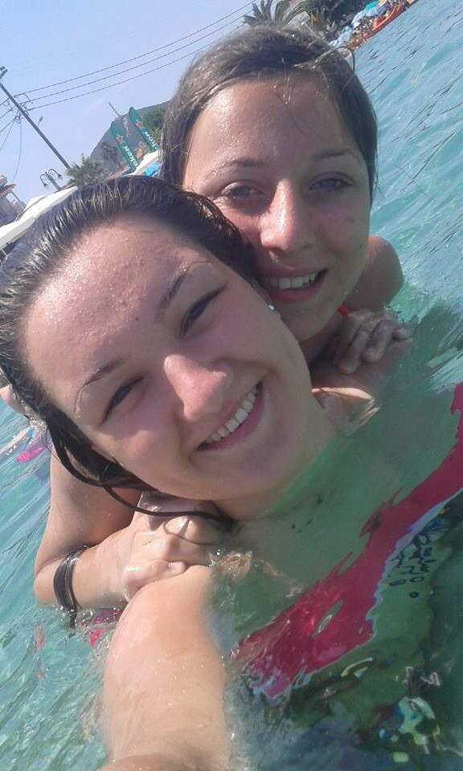
Let’s take a selfie

Slide 4
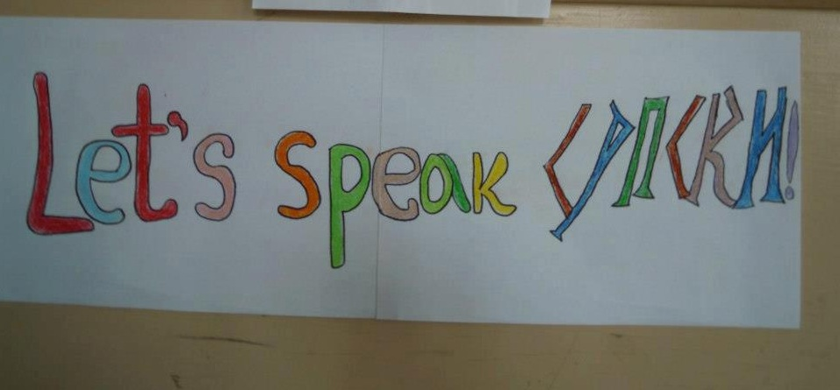
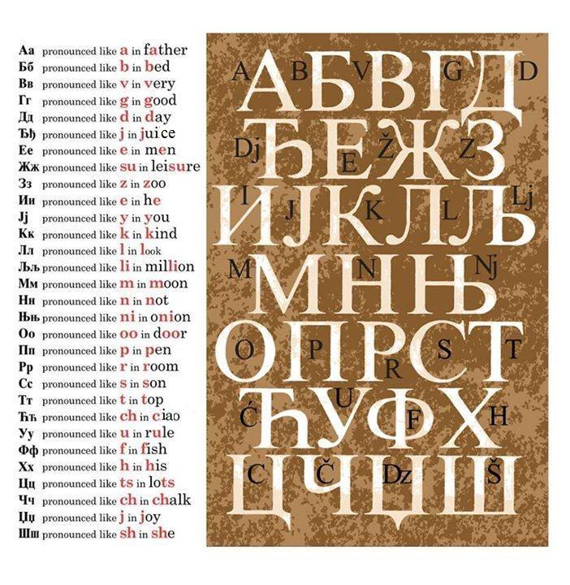
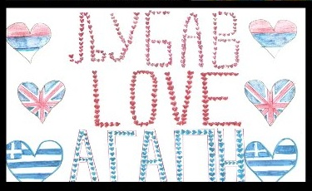
Let’s speak Srpski
According to linguists, thousands of languages will disappear within the next hundred years.
The English language is colonizing the world. Political, cultural and technical influences from abroad are not necessarily negative, on the contrary, they can often prove to be enriching. But because of an accelerating influence, the English language has come to be a threat towards our Serbian language and our Serbian culture.
There is no doubt that the English language is a very important medium of education.
But that is no reason why we should forget the importance of our mother tongue and the traditions and culture of which it is an integral and important part.
It is the Serbian language that makes Serbian a nation. It is the language we communicate with people throughout this tiny country of ours. Once we stop paying due respect to our mother tongue, our history, culture and traditions could also become a matter of shame for us. And the result of such a development can only be bitter and painful.

Slide 5
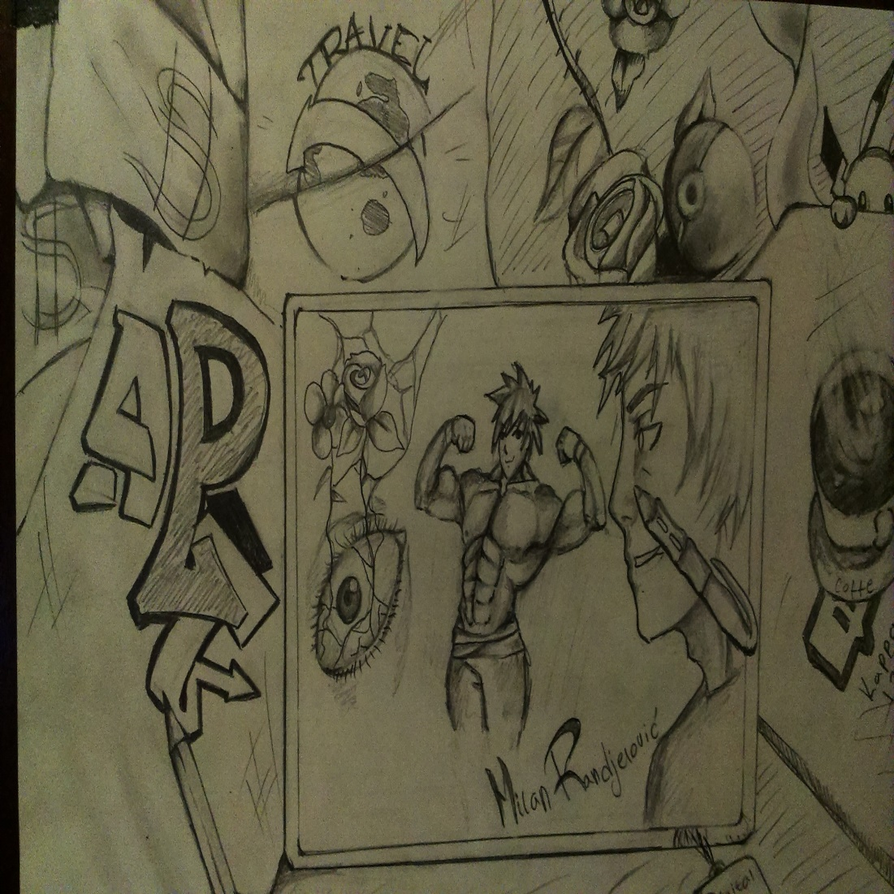
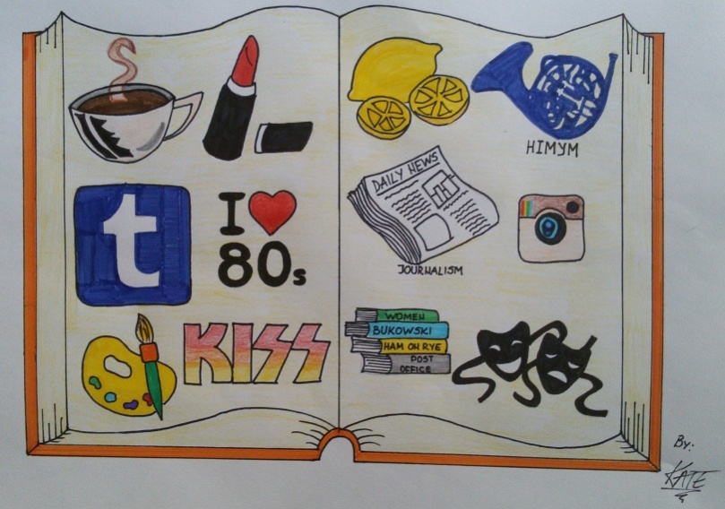
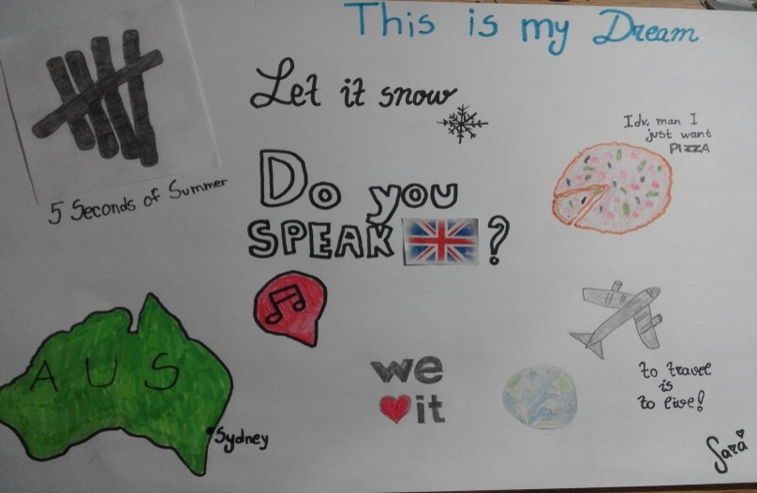
Draw your dream

Slide 6
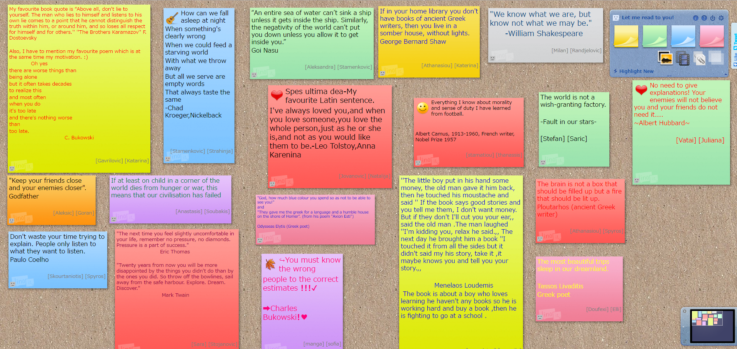
Let me read to you

Slide 7
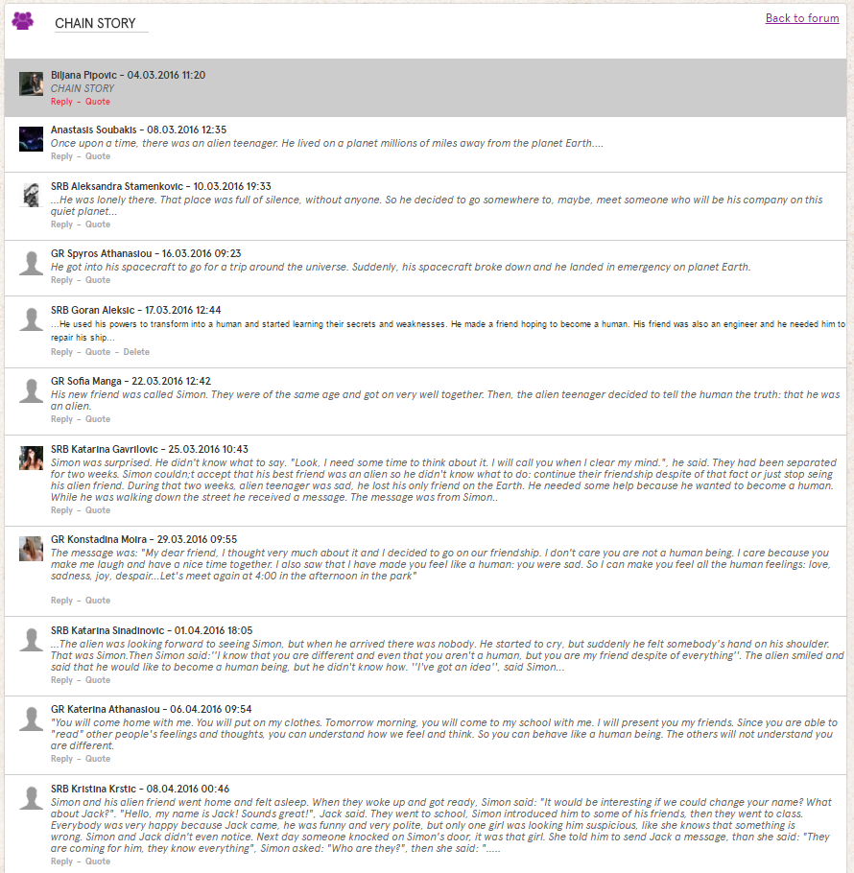
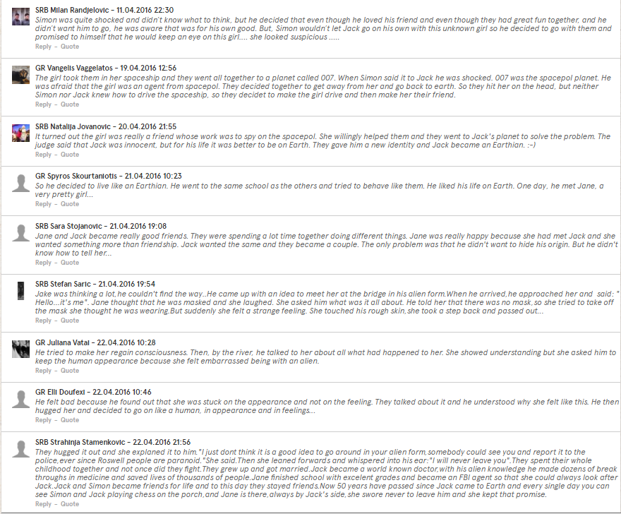
Chain story

Slide 8
Outcomes
By the end of the project students have developed different skills (speaking and writing in English, verbal and nonverbal communication, written and visual communication …).
They learned a lot about each other’s countries and the ways people communicate. They have developed research skills, explored their creativity, created videos, padlets, digital and hand paintings, written a story, and above all had FUN!

